Slide 1
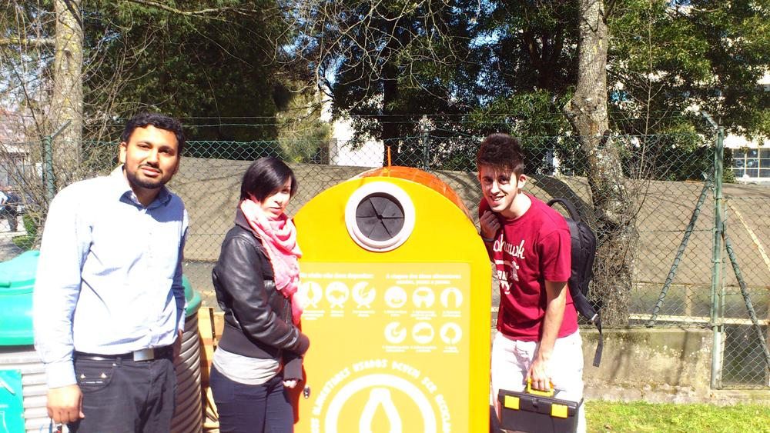
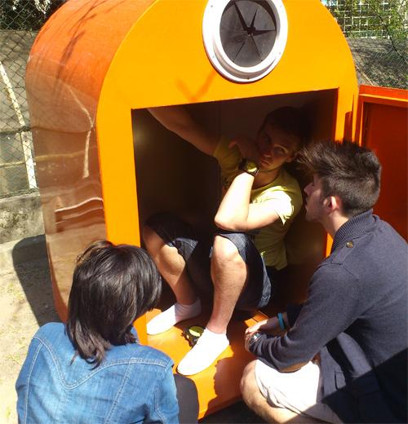
MIDTERM Presentation
Level Monitoring System
for a Waste Oil Storage Tank
Marcos Moura N. 1090419
Olga Olejniczak N. 1111822
Naeem Ahmad N. 1111821
Mihkel Tasa N. 1111820

Slide 2
Table of contents
1. Summary
2. Problems
3. Objectives
4. State of the Art
5. Project Development
6. Eco-efficiency Measures for Sustainability
7. Marketing Plan
8. Conclusion

Slide 3
Summary
Nowadays recycling companies who deal with waste oil have huge responsibility towards humanity.
By avoiding checking containers so often and reduce the need for resources the companies can create good conditions to be leaders in the market.

Slide 4
Problem
The waste oil recycling companies :
Do not know when their containers are full or not;
Lose money checking the containers;
Transportation process is less efficient.

Slide 5
Objectives
To develop a system that will enable measuring the level of wasted oil in the containers by using electronics devices that check them constantly.
To compare different types of sensors, control communication systems, web interfaces and batteries.
To accomplish all our goals with the lowest budget possible so the system can be obtained not just for big companies but also for private use.

Slide 6
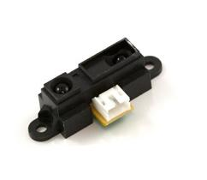
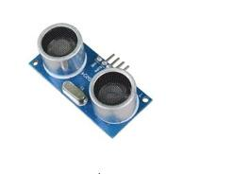
State of the Art - sensors
Level/Height measuring sensors
Level measurement sensors are used to measure fluid or solid level within a range. Generally, these sensors produce an analog output that directly correlates to the level in the vessel. To create a level management system, the output signal is linked to a micro-controller.
Ultrasonic sensor Infra-red

Slide 7
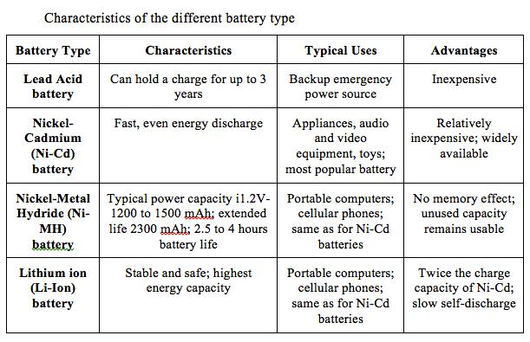
State of the Art - Battery

Slide 8
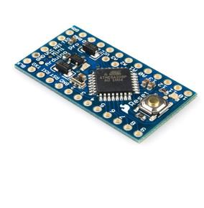
State of the Art - Micro-Controller
A micro-controller is
a small computer on a single integrated circuit containing a processor core, memory, and programmable input/output peripherals;
designed for embedded applications;
used in automatically controlled products and devices.
The micro-controller is the main component of our system:
It will control everything and process everything,
It will be responsible for controlling all the other components in our system.
We chose the arduino pro mini which is a development board with the micro-controller and also some protection systems, as well as power regulation circuits and so on.

Slide 9
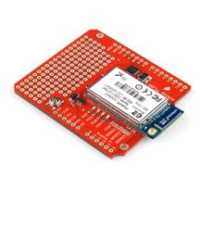
State of the Art - Communication
Wireless telecomunications:
Is the transfer of information between two or more points that are not physically connected.
In this project we will be using a Wifi communication system to transfer data between the measurement system and the web interface.
Wi-Fi:
is a popular technology that allows an electronic device to exchange data wirelessly (using radio waves) over a computer network.

Slide 10
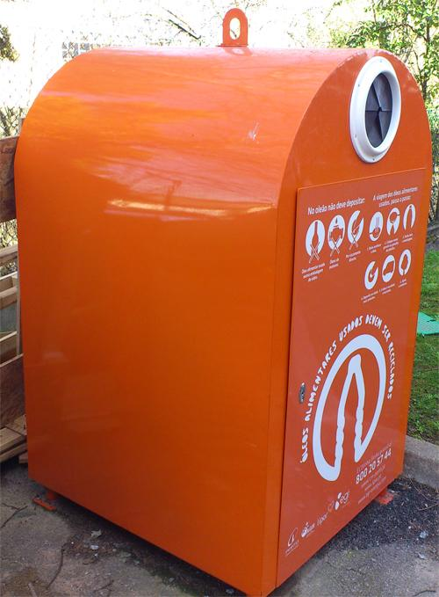
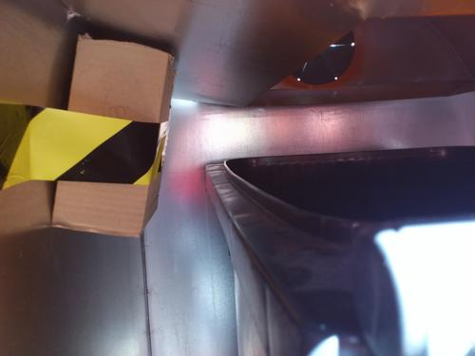
Project Development

Slide 11
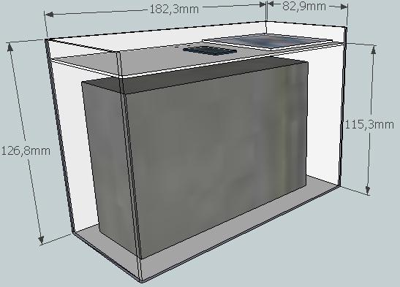
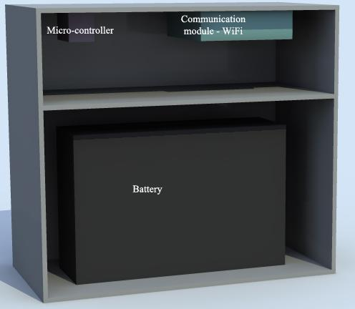
Project Development
The enclosure

Slide 12
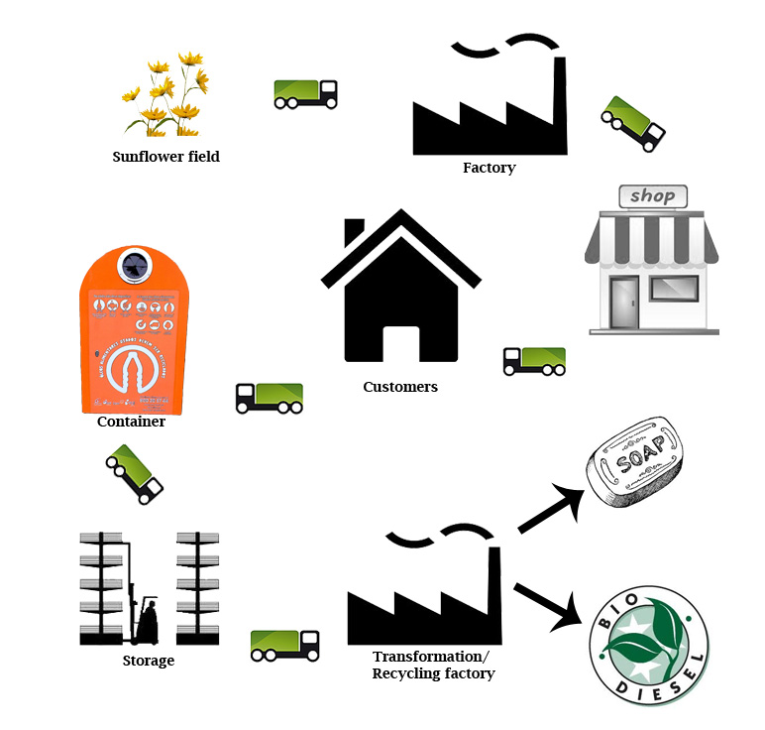
Eco-efficiency measures for sustainability

Slide 13
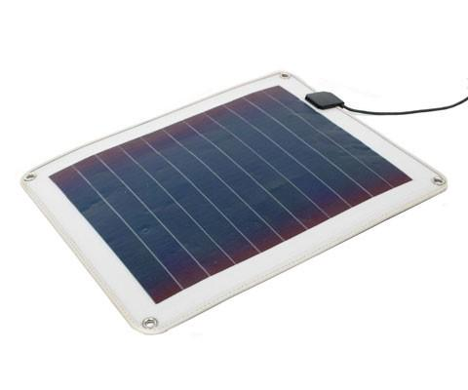
Eco-efficiency measures for sustainability
Battery
Recyclable
These are recycled by grinding them, neutralizing the acid, and separating the polymers from the lead. The recovered materials are used in a variety of applications, including new batteries.
Solar panel

Slide 14
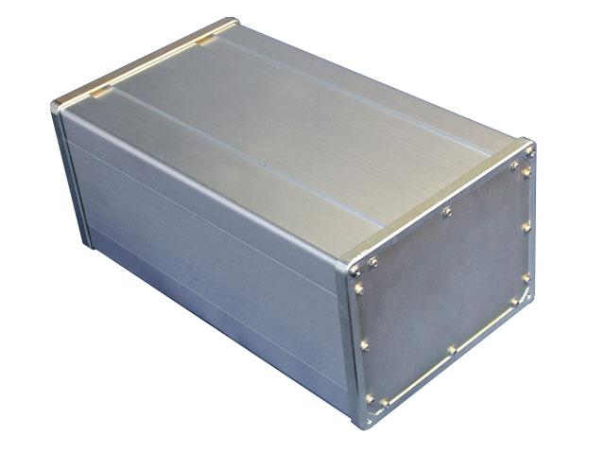
Eco-efficiency measures for sustainability
Aluminium enclosure

Slide 15
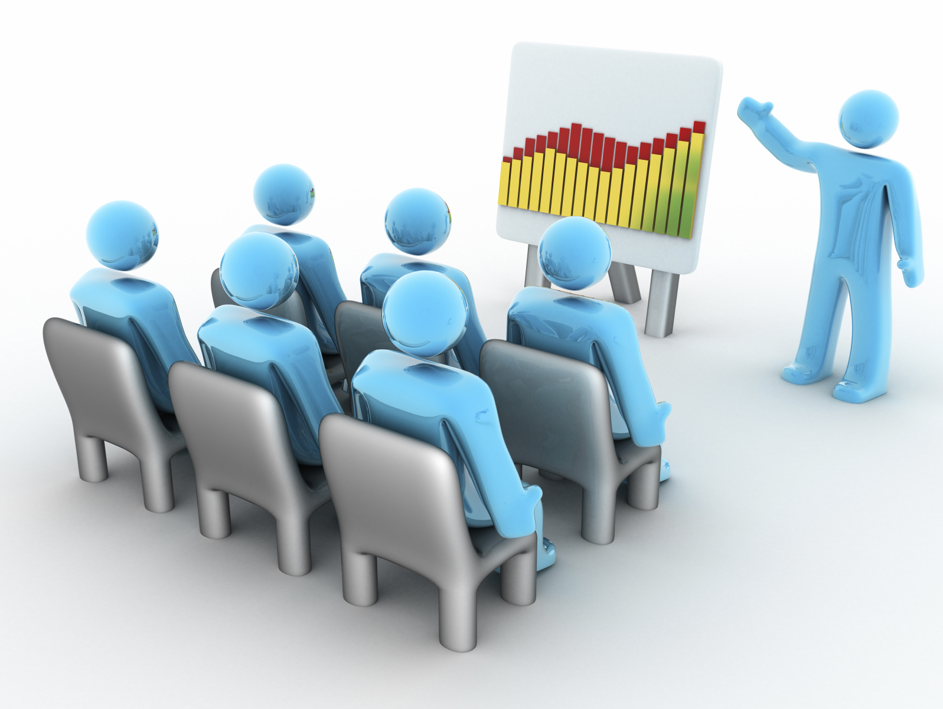
Marketing Plan
Market description and current market situation.
Needs and Corresponding Features/Benefits of or product.

Slide 16
Market description and current market situation
Our Product is innovative
Market of Professional use and private customer
Creating a new segment
Companies using related technologies
There are no major barriers to entry.
In Portugal we didn´t found any competitors (there must be some)
Companies from other geographical areas and with similar products

Slide 17
Competitors
Company | Product | Price | Function | Customers
Sonotec (Germany) | Sonolevel 10 | 499,99 € | -it can measure the distance from 12 cm to 250 cm. -working with ultrasound -adjustable -only a local interface | -owners of heating oil tanks in -most for landlord
VEGA Grieshaber KG | VEGASON 61 to 63 | 902,14 € | liquids: 0.4 … 8 m solids: 0.4 … 3,5 m | -B2B Marketing -process industry
Endress Hauser | Prasonic SFD And FMU 90 | 1090 € |  | -B2B Marketing -process industry
46 companies in Germany working with same technology
Not our first market (be carful)

Slide 18
Needs and Corresponding Features/Benefits of our product (level1000)
Targeted segment | Customer need | Corresponding Feature/Benefit
Recycling companies(business) | Information about containers capacities | Ultrasonic sensor will measure this
 | Don´t want to check containers every time | Wifi module for communication(with web interface)
 | Logistic process | Web interface will help to create a better logistic and collecting process (overview).
Private consumers | Information about the container capacity | Ultrasonic sensor will measure this.
 | Don´t want to check the container every time | Wifi module for communication (with web interface)

Slide 19

Marketing strategy
Positioning
Product strategy
  The level1000 will be introduced to the market with a price of 300 € per unit.
Pricing strategy
  The level1000 will be sold with a one year warranty. Plus in the first year we provide a full service for free.
Distribution strategy
  The main strategy will be to sell our product through our website .

Slide 20

Action programmes
Divided into 6 months
Main actions will be:
  Creating web page
  Making video
  Contacting with companies
  Making leaflets
  Publishing articles
  Starting to make plans for the next year.

Slide 21
Conclusions
Achievements:
As we have already mentioned to distribute the conception we needed
to find a special kind of sensor - we chose ultrasonic one (Ultrasonic Distance Measuring Module HC-SR04);
the monitoring system that would automatically send an alert message when the container would be full – we chose Arduino pro min plus Wi-Fi shield;
the battery - the lead acid one because of possibility to recharging it and quite low price;
the special and necessary box - the one made of the aluminium, which would keep all things together;
We have already started to consider the programming part of the project;
We did some tests using the sensors and tried to fix the enclosure inside the container.

Slide 22
References & Bibliography
1) http://www.webopedia.com/TERM/W/Wi_Fi.html
2) http://en.wikipedia.org/wiki/File:Nested_sustainability-v2.gif
3)http://mechanical.poly.edu/faculty/vkapila/ME3484/Readings/NV27-Measuring%20Water%20Level.pdf ways of level measurement
4)http://arduino-direct.com/sunshop/index.php?l=product_list&c=1 store
5)http://batteryuniversity.com/learn/article/can_the_lead_acid_battery_compete_in_modern_times
6)http://en.wikipedia.org/wiki/Lead%E2%80%93acid_battery
7)http://www.windsun.com/Batteries/Battery_FAQ.htm

Slide 23
Thank You
For Your Attention

