Slide 1
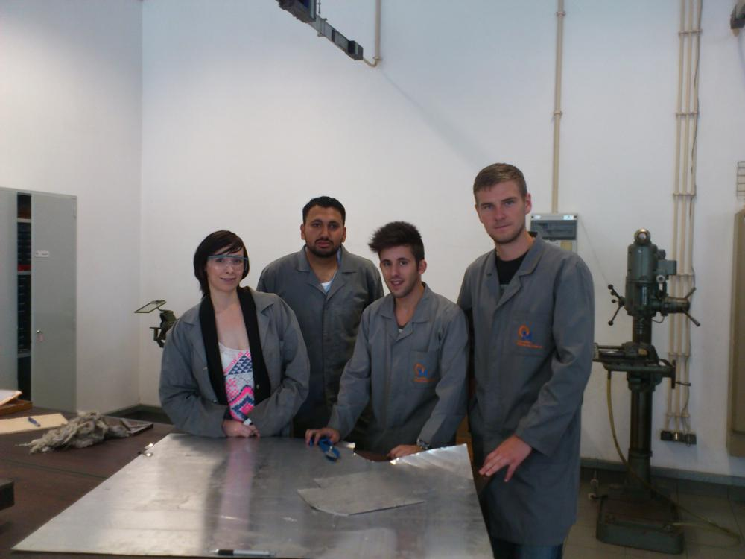
Level Monitoring System
for a Waste Oil Storage Tank
Naeem Ahmad 1111821
Marcos Moura 1090419
Olga Olejniczak 1111822
Mihkel Tasa 1111820

Slide 2
Table of contents
1. Summary and Objectives
2. Problem Statement
3. State of the Art
4. Project Development
5. Conclusion
6. Test
7. Video

Slide 3
Summary & Objectives
Abstract design
Nowadays recycling companies who deal with waste oil have huge responsibility towards humanity.
Competition for the best position is tough and it is necessary to optimize their services and production.
Primary idea of the project
Developing a system that will enable measuring the level of waste oil deposited in the containers by using electronic devices that check them constantly.

Slide 4
Problem Statement
The waste oil recycling companies :
•Do not know when their containers are full or not;
•Lose money checking the containers;
•Transportation process is less efficient.

Slide 5
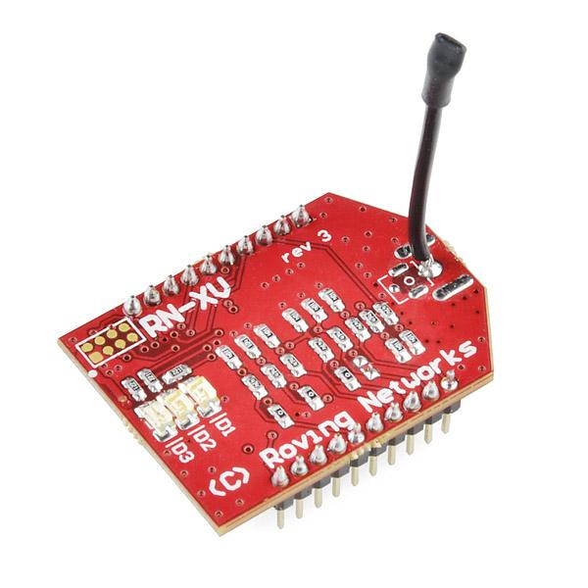
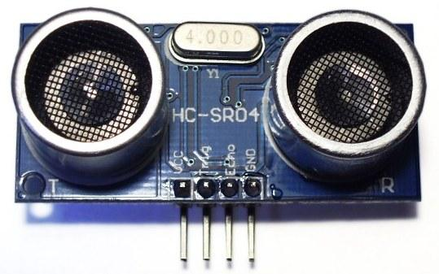
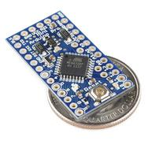
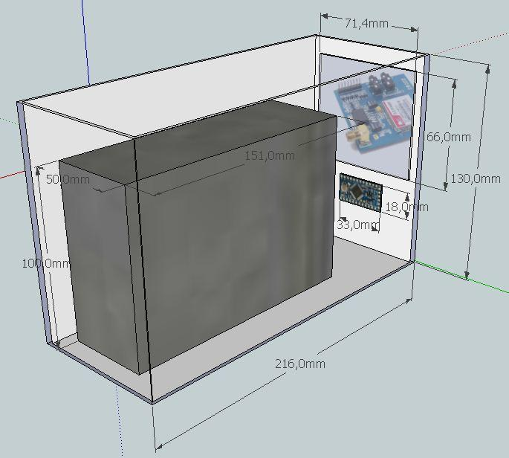

State of the Art

Slide 6
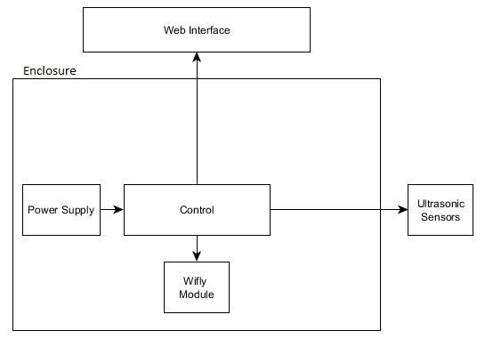
Development

Slide 7
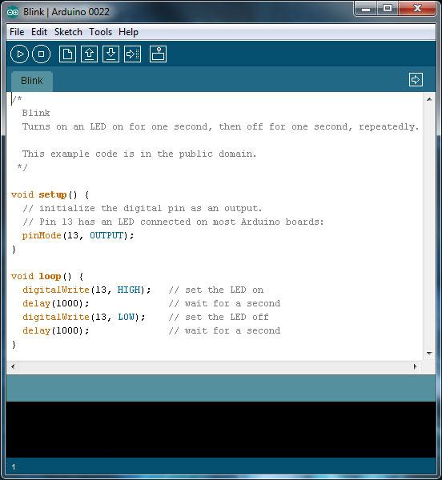
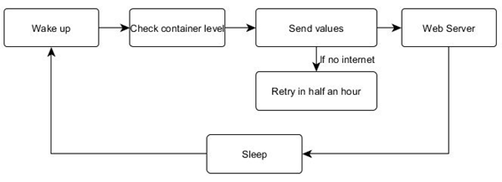
Development
Control and Programming
Setup
Main loop
Read sensors
Sleep (Watchdog)
Send values

Slide 8
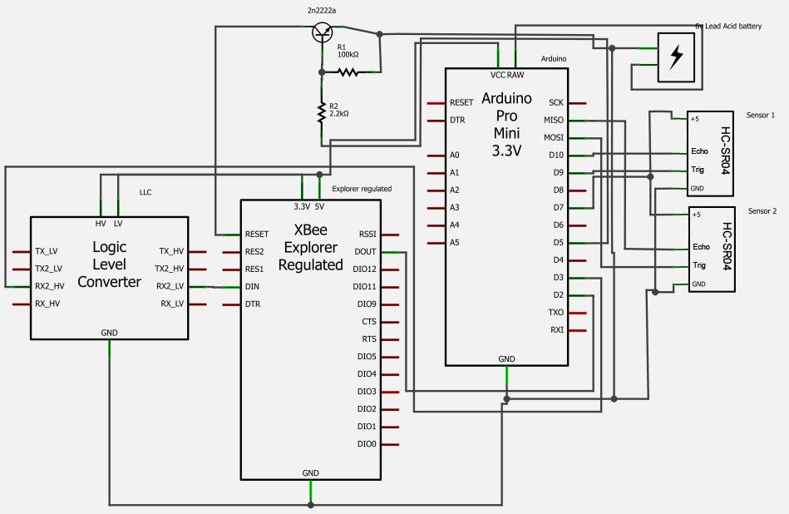
Development
Schematics

Slide 9
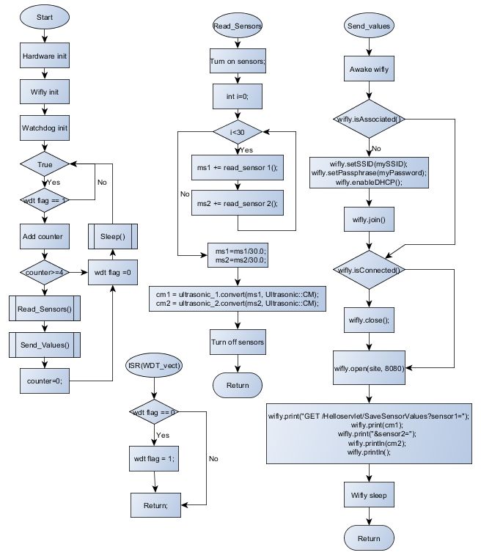
Development
Fluxograms

Slide 10

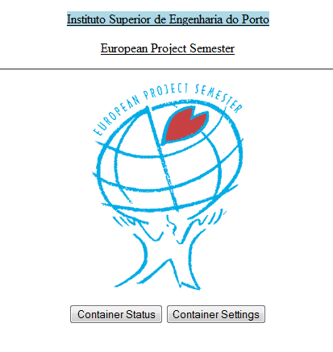
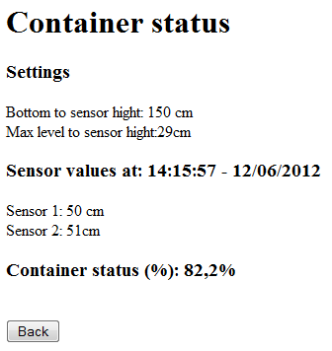
Development
Web Interface

Slide 11
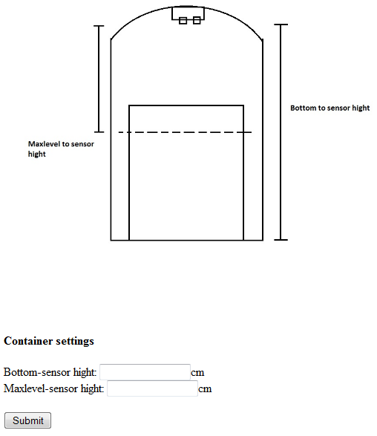
Development

Slide 12
Conclusions
Achievements:
We learned how to work in group with people from different fields of study.
Learned many things about project management and teamwork.
Managed to make everything work.
We worked as a group.
We got new knowledges.

Slide 13
Video Team 4
Let's watch the video

Slide 14
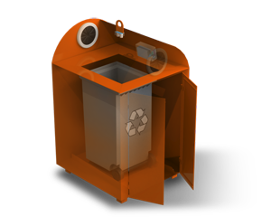
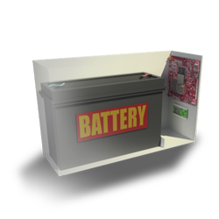
Test

Slide 15

THANK YOU
FOR YOUR ATTENTION

